Slide 1
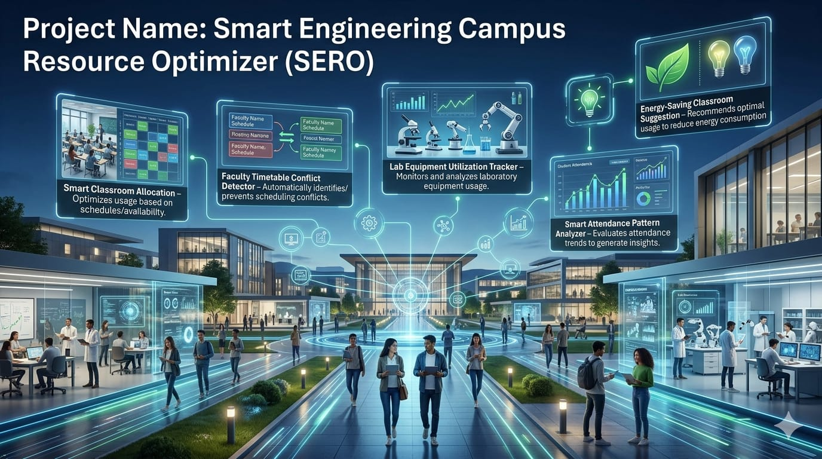

Slide 2
Team Structure
Project Manager
Java Developer (2 members)
Algorithm Designer
Online Researcher
Data Manager
UI / Output Designer
Tester
Documentation Writer
Presentation Designer

Slide 3
Java Developer
Responsible for writing the main Java program.
Tasks:
Create the menu system using switch and loops
Implement arrays and 2D arrays for storing faculty, classrooms, and timetable
Write functions for adding faculty, generating timetable, and reports
Implement conflict detection logic
Skills used: Java basics, arrays, loops, methods.

Slide 4

Algorithm & Logic Designer
Focuses on problem solving and system logic.
Tasks:
Design timetable generation logic
Plan classroom allocation algorithm
Decide how conflicts will be detected
Analyze time complexity of sorting and optimization
Skills used: logical thinking, algorithms, problem analysis.

Slide 5
Online Researcher
Collects information needed for the project.
Tasks:
Research smart campus systems
Study how colleges manage timetables
Find examples of resource optimization
Provide ideas for improving the system
Skills used: internet research, information analysis.

Slide 6
Data Designer / Data Manager
Handles sample data used in the program.
Tasks:
Create lists of faculty names, subjects, classrooms
Prepare student strength and classroom capacity data
Organize data in arrays or tables
Skills used: organization, data structure basics.

Slide 7
UI / Output Designer
Improves how the program interacts with the user.
Tasks:
Design menu structure
Format console output and reports
Use StringBuilder for clean reports
Skills used: program usability, formatting.

Slide 8
Tester / Debugging Engineer
Checks whether the program works correctly.
Tasks:
Test all menu options
Identify errors and logical bugs
Check conflict detection and room allocation
Suggest improvements
Skills used: debugging, logical checking.

Slide 9
Documentation Writer
Prepares the project report.
Tasks:
Write project introduction
Explain Java concepts used
Describe system flow and algorithms
Prepare method explanations and diagrams
Skills used: technical writing.

Slide 10
Presentation Designer
Creates the PowerPoint and final presentation.
Tasks:
Convert project explanation into slides
Add flowcharts and diagrams
Prepare demo explanation
Skills used: communication and presentation.

Slide 11
Project Manager / Team Coordinator
Ensures the project is completed on time.
Tasks:
Assign tasks to team members
Track project progress
Coordinate between coding, research, and documentation teams
Skills used: leadership, planning.

